Slide 1

INTEGRATED PROJECT
CALENDAR USING C GRAPHICS
COMPUTER SCIENCE AND ENGINEERING
B.E. Batch-2015
in
May-2017

Slide 2
CALENDAR USING C GRAPHICS
Teacher Incharge:
Mrs. PRIYANKA GUPTA
ASSISTANT PROFESSOR (CSE)
Prepared By:
Prashant Jaswal : 1510991449
Pulkit Lamba : 1510991472
Puneet Chopra : 1510991475
Puneet Singh : 1510991478

Slide 3
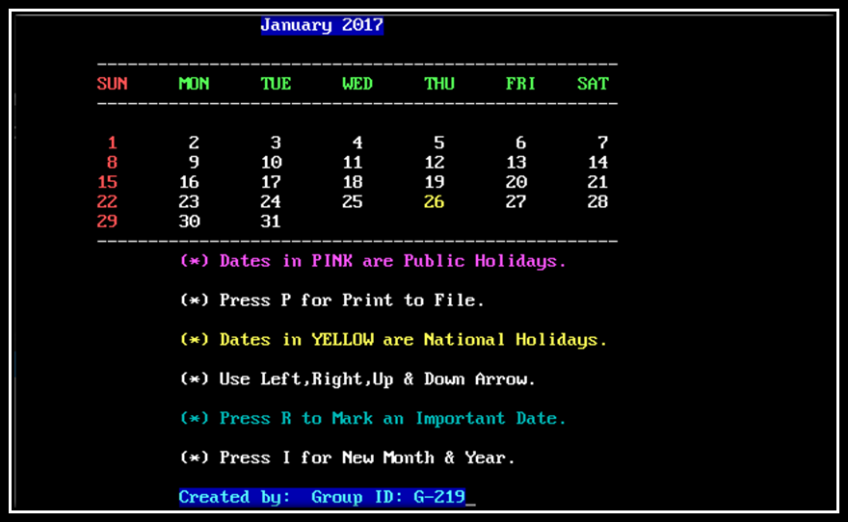
CALENDAR USING C GRAPHICS
Project Statement
CALENDAR USING C GRAPHICS

Slide 4
CALENDAR USING C GRAPHICS
Project Abstract-
This project is concerned with building and programming a Calendar Tool so that users can view and manage their appointments quickly, reliably and electronically. This program can exchange important data about events so that people can schedule meetings with anyone who is using a similar kind of program.
The Calendar Application presented here is a very simple console application developed using C programming language. It is built using graphics properties, and utilizes many windows properties to give the application a colour look and feel. This application contains customized colour for different events like holidays, reminder etc. Any user can pull out the information from the application and is very easy to use. Furthermore, this application will only visualize reminders for the user events.
It is compiled in Turbo c++ using GCC compiler.

Slide 5
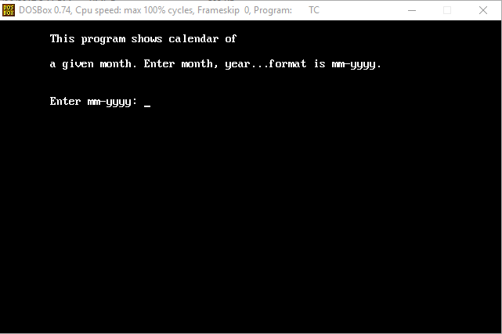
CALENDAR USING C GRAPHICS
WORKING OF OUR PROJECT-
Our program will start by showing an input screen to the user where it will accept a month and a year in mm-yyyy format

Slide 6
CALENDAR USING C GRAPHICS
Once user enters a valid month-year and hits Enter key, it should display the calendar of the entered month & year.
If user presses Left-arrow key, it will show the previous month.
Similarly if user presses Right-arrow key, it will show the next month.
Once user hits Up-arrow key, it will show month of the next year.
If user hits Down-arrow, it will show the month of the previous year.
If the user press R key, it will ask to mark an important date and colour will change of the same.
If P is pressed, it will export the month details in a text-file with file name as “MONTHYEAR.txt”
Pressing Esc, will exit the program.

Slide 7
CALENDAR USING C GRAPPHICS
Flow Diagram
CALENDAR DISPLAYED
MAIN PAGE
(ASKING INPUT)
PRESSING ESCAPE TO EXIT
PERFORMING MULTIPLE FUNCTIONS BY PRESSING KEYS
RESPONSE OF THAT KEY’S FUNCTION

Slide 8
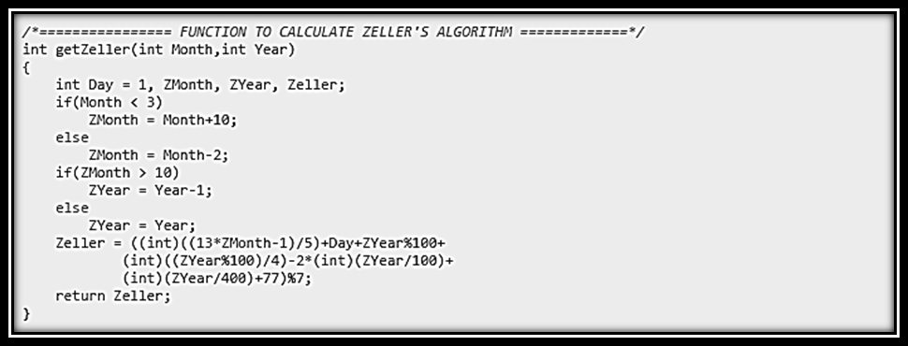
CALENDAR USING C GRAPHICS
FUNCTIONS USED
Zeller's Algorithm- can be used to determine the day of the week for any date in
the past, present or future for any dates between 1582 and 4902. We're using this
function to get the weekday of the 1st day of given month.

Slide 9
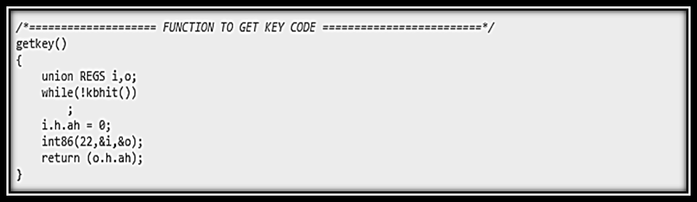
CALENDAR USING C GRAPHICS
Function to get Key code-kbhit function is used to determine if a key has been pressed or not. To use kbhit function in your program you should include the header file "conio.h". If a key has been pressed then it returns a non-zero value otherwise returns zero.

Slide 10
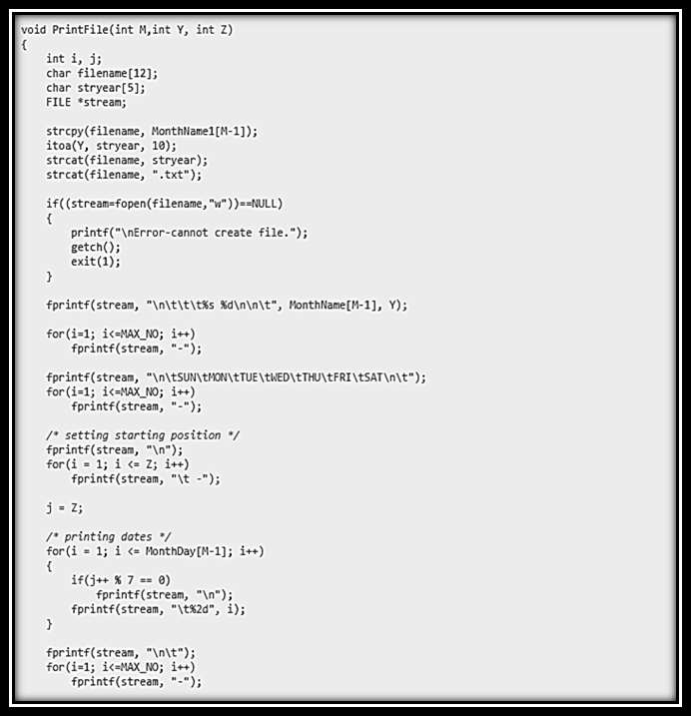
CALENDAR USING C GRAPHICS
FILE HANDLING - function will be used to print the output in a text file and save in the disk.

Slide 11

CALENDAR USNIG C GRAPHICS
Snapshots/Features
National Holidays Marked In Yellow

Slide 12
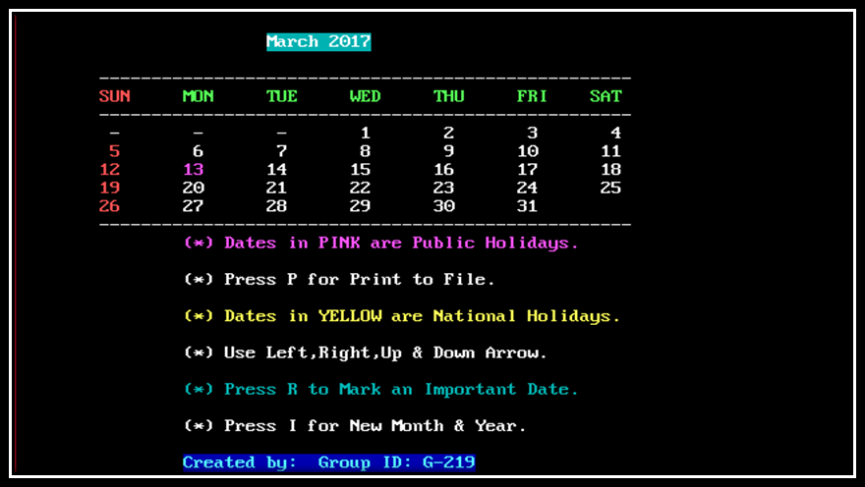
CALENDAR USNIG C GRAPHICS
Snapshots/Features
Public Holidays Marked In Pink

Slide 13
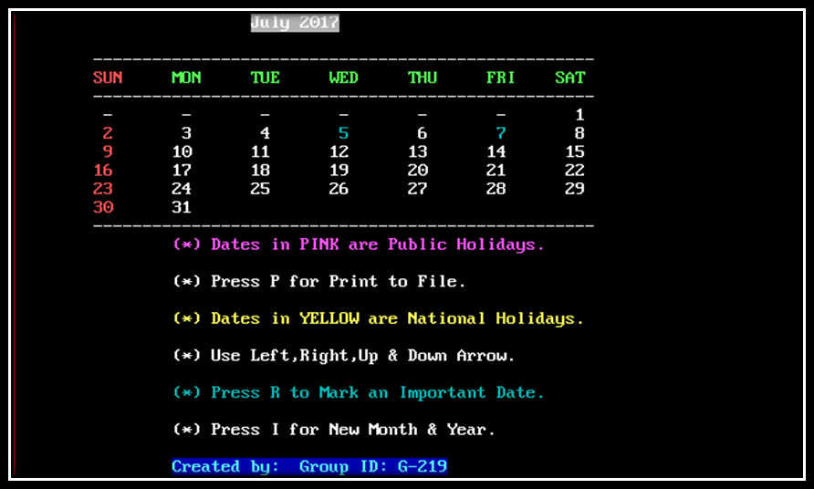
CALENDAR USING C GRAPHICS
Snapshots/Features
Marked 5th & 7th as Important date.

Slide 14
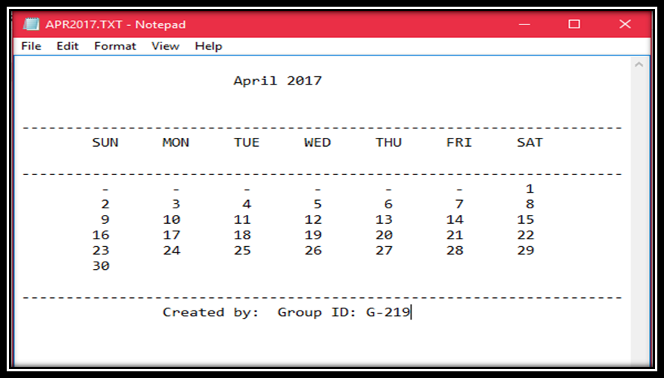
CALENDAR USING C GRAPHICS
Snapshots/Features
Print of Calendar/Exported to text file

Slide 15
CALENDAR USING C GRAPHICS
FUTURE SCOPE
Accounts can be implemented for each person to store its events and add a note.
That can be accessed only by the other users having password with a 2 step verification.
Merging/Unmerging Important dates on one or more parameters can be done also, transferring them to new date can be added.
We can attract more users to use this application by providing better interface and advanced functionalities.
Moreover, this application can be used to fetch events from not only Google calendar but also from other available calendars as well.
Even if we make it to link with the current date and time (GMT), using device’s location services, then we can add an alarm or a type of notification on users device to check what important has to be done on that day.

Slide 16
CALENDAR USING C GRAPHICS
Limitations-
Added reminders cannot be removed.
No link to current date or time.
Any type of note cannot be added on date.
No notification or any type of alert.

Slide 17
CALENDAR USING C GRAPHICS
THANK YOU

